Slide 1



Improving Employee Retention by Predicting Employee Attrition Using Machine Learning
Created by:
Ferry Setefanus
ferrysetefanus@gmail.com
https://www.linkedin.com/in/ferry-setefanus-257098170/
Data Science enthusiast with a bachelor's degree in information systems at STMIK Pontianak. Passionate in data science, data analysis, machine learning and loves learning new things related to technology. Have experience in warehousing field for 4 years. Currently looking for an opportunity to work in the data field.

Slide 2
Overview
Human resources (HR) is the main asset that needs to be managed properly by the company so that business goals can be achieved effectively and efficiently. On this occasion, we will face a problem about human resources in the company. Our focus is to find out how to keep employees to stay in the current company which can result in increased costs for employee recruitment and training for those who have just entered. By knowing the main factors that cause employee disengagement, companies can immediately address them by creating programs that are relevant to employee problems. “

Slide 3
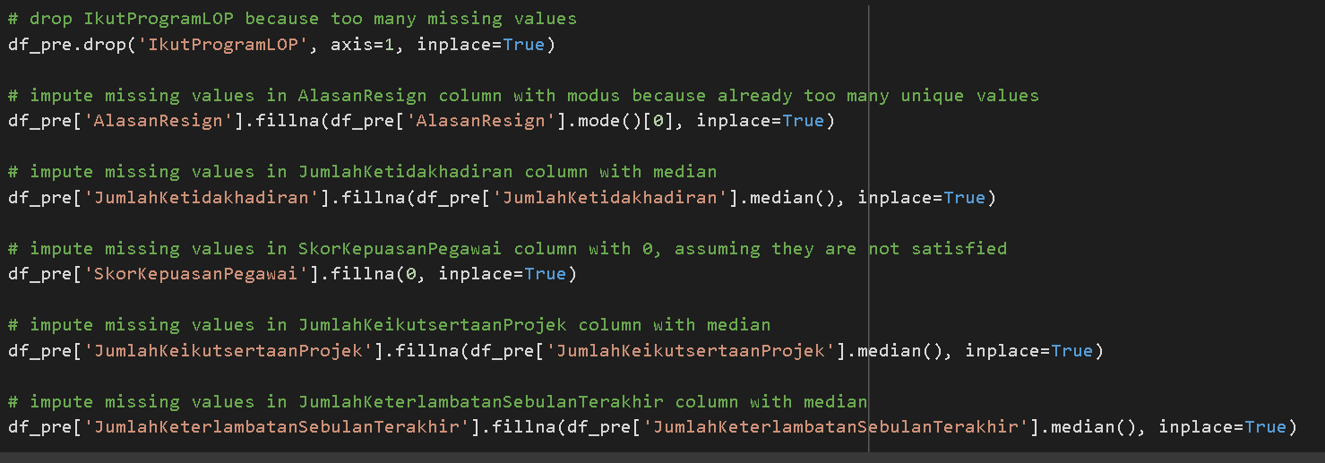
Data Preprocessing
First step, impute the columns that have missing values. Some columns that have missing values are IkutProgramLOP, AlasanResign, JumlahKetidakhadiran, SkorKepuasanPegawai, JumlahKeikutsertaanProjek dan JumlahKeterlambatanSebulanTerakhir.
For more details, see jupyter notebook here

Slide 4
Data Preprocessing
The imputation treatment for missing values in each column is :
IkutProgramLOP : drop the columns because too many missing values.
AlasanResign : impute missing values in AlasanResign column with modus because already too many unique values if we make another new value.
JumlahKetidakhadiran : impute missing values with median, because median is more robust to various data distributions.
SkorKepuasanPegawai : impute missing values with 0, assuming they are not satisfied.
JumlahKeikutsertaanProjek : same treatment like JumlahKetidakhadiran column.
JumlahKeterlambatanSebulanTerakhir : same treatment like JumlahKetidakhadiran column.
For more details, see jupyter notebook here

Slide 5
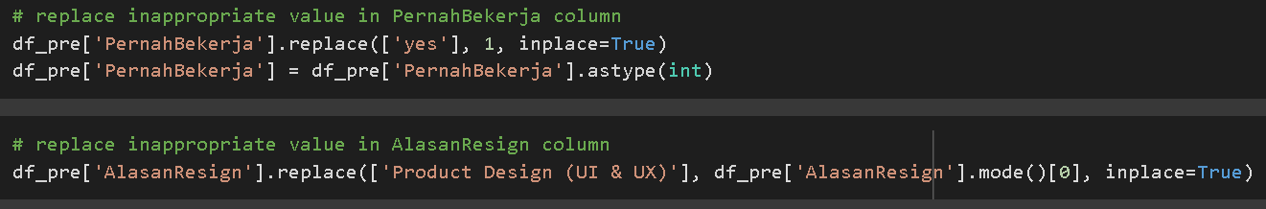
Data Preprocessing
Next step is to replace the inappropriate values in the PernahBekerja and AlasanResign columns. In the PernahBekerja column, change the 'yes' value to 1 and change the column type to numeric. As for the AlasanResign column, there is an inappropriate value, namely 'Product Design (UI & UX)' which is not suitable as a reason to resign and is replaced with a mode value in the column.
For more details, see jupyter notebook here

Slide 6
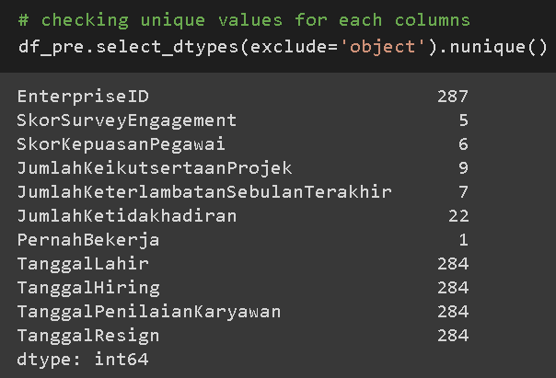
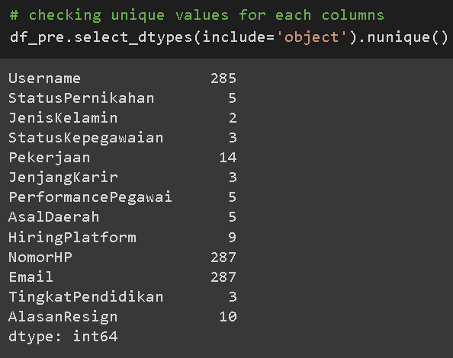
Data Preprocessing
then drop columns that have too many unqiue values and those that only have 1 unique value. Those columns are Username, NomorHP, Email, PernahBekerja, EnterpriseID.
For more details, see jupyter notebook here

